Slide 1
Clustering algorithms Febrero 19 de 2019 - Febrero 26 de 2019
Carlos Alejandro Trujillo Anaya – carlostrujillo@itm.edu.co
M212
Electronics and telecomunications department
Course belonging to “Maestría en Automatización y Control Industrial”.
Tuesday 18-21

Slide 2
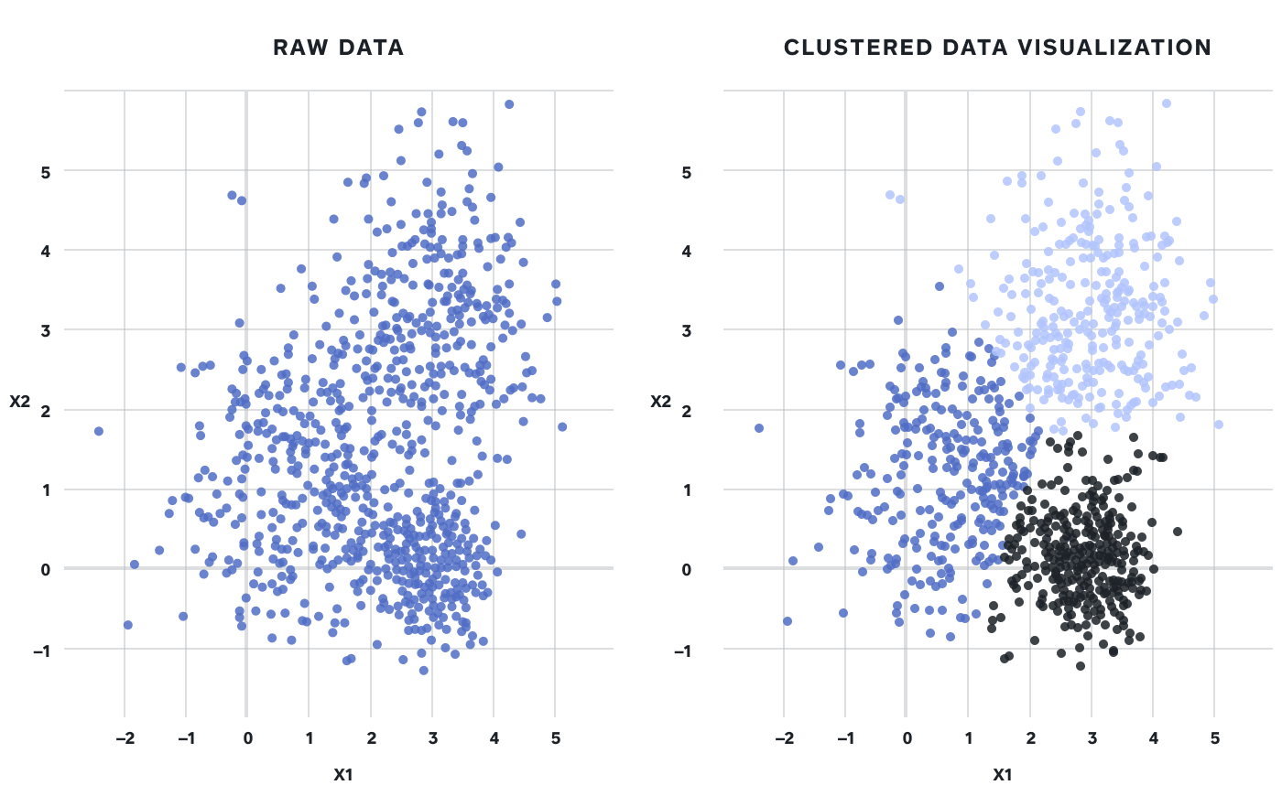
Clustering (definitions)
Instances, in the same cluster, must be similar as much as possible.
Instances, in the different clusters, must be different as much as possible.
Measurement for similarity and dissimilarity must be clear and have the practical meaning.
Jain A, Dubes R (1988) Algorithms for clustering data. Prentice-Hall, Inc, Upper Saddle River

Slide 3
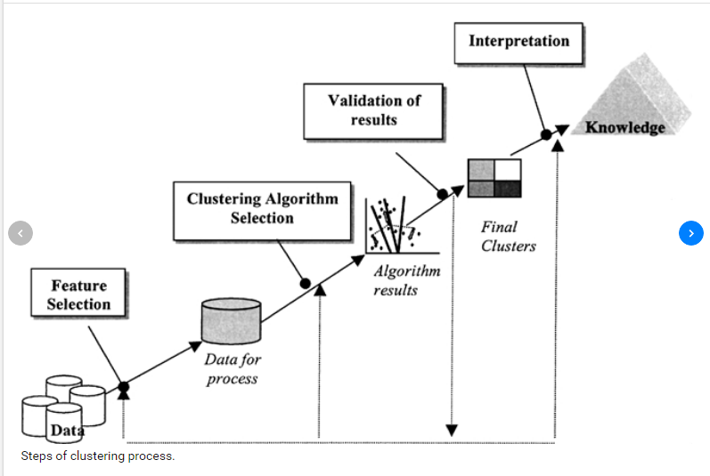
The standard process of clustering…
Feature extraction and selection: extract and select the most representative features
from the original data set;
(2) Clustering algorithm design: design the clustering algorithm according to the characteristics of the problem;
(3) Result evaluation: evaluate the clustering result and judge the validity of algorithm;
(4) Result explanation: give a practical explanation for the clustering result;
Xu R, Wunsch D (2005) Survey of clustering algorithms. IEEE Trans Neural Netw 16:645–678

Slide 4
Distance and Similarity
Distance (dissimilarity) and similarity are the basis for constructing clustering algorithms.
For quantitative data features, distance is preferred to recognize the relationship among data.
Similarity is preferred when dealing with qualitative data features.
Xu R, Wunsch D (2005) Survey of clustering algorithms. IEEE Trans Neural Netw 16:645–678

Slide 5
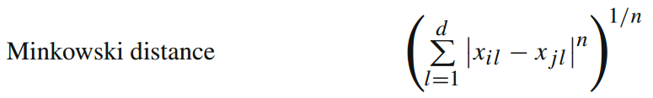
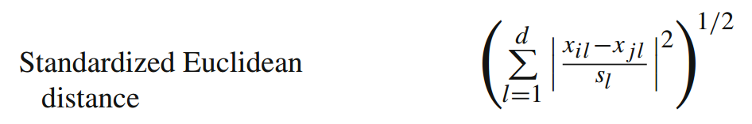
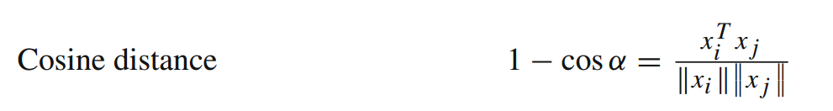
Distance functions (a few)
Xu R, Wunsch D (2005) Survey of clustering algorithms. IEEE Trans Neural Netw 16:645–678

Slide 6
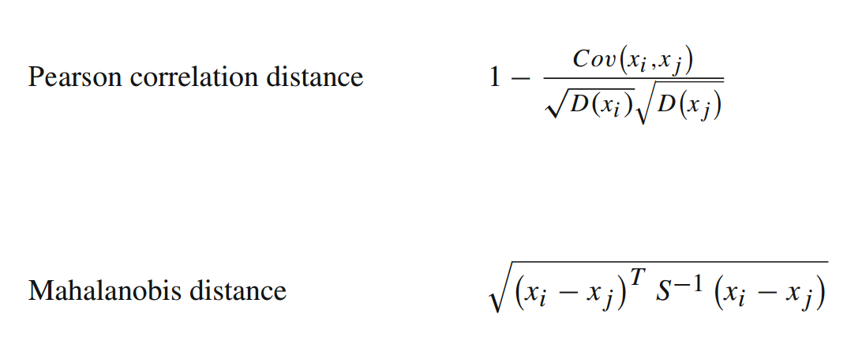
Distance functions (a few)
Xu R, Wunsch D (2005) Survey of clustering algorithms. IEEE Trans Neural Netw 16:645–678

Slide 7

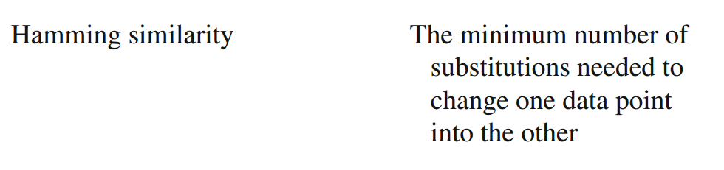
Similarity functions (a few)
Everitt B, Landau S, Leese M (2001) Clustering analysis, 4th edn. Arnold, London
Gower J (1971) A general coefficient of similarity and some of its properties. Biometrics 27:857–871

Slide 8
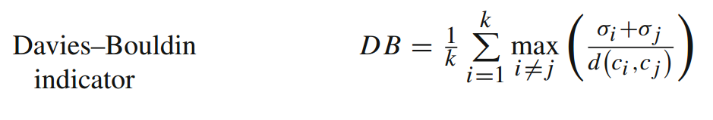
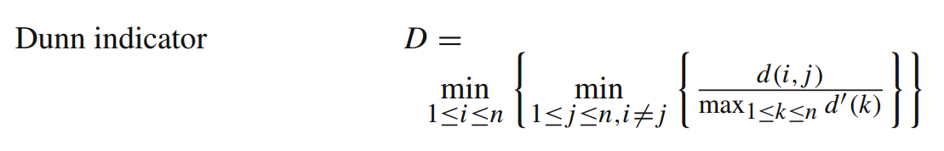
Evaluation indicator (internal evaluators)
The main purpose of an evaluation indicator is to test the validity of algorithm.
Estivill-Castro V (2002) Why so many clustering algorithms: a position paper. ACM SIGKDD ExplorNewsl 4:65–75

Slide 9
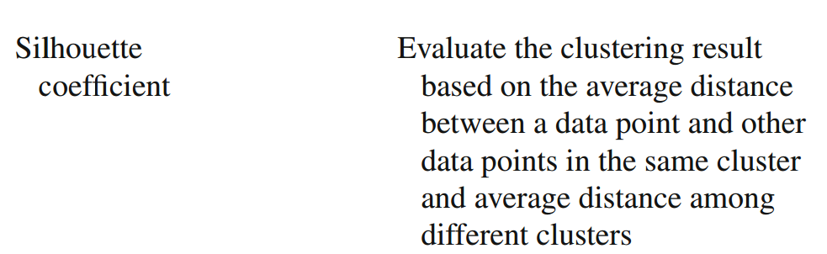
Evaluation indicator (internal evaluators)
The main purpose of an evaluation indicator is to test the validity of algorithm.
Estivill-Castro V (2002) Why so many clustering algorithms: a position paper. ACM SIGKDD ExplorNewsl 4:65–75

Slide 10
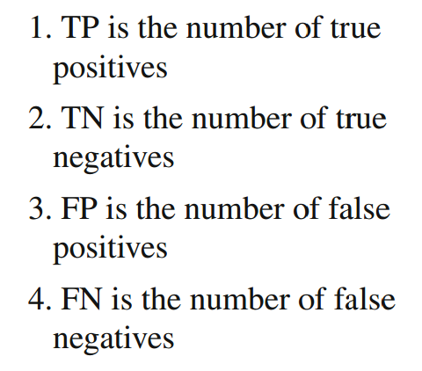

Evaluation indicator (external evaluators – gold standard)
The main purpose of an evaluation indicator is to test the validity of algorithm.
Färber I, Günnemann S, Kriegel H, Kröger P, Müller E, Schubert E, Seidl T, Zimek A (2010) On using class-labels in evaluation of clusterings. In MultiClust: 1st international workshop on discovering, summarizing and using multiple clusterings held in conjunction with KDD, Washington, DC

Slide 11
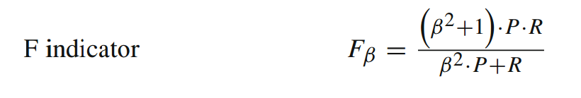

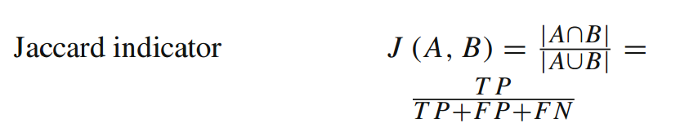

Evaluation indicator (external evaluators – gold standard)
The main purpose of an evaluation indicator is to test the validity of algorithm.
Färber I, Günnemann S, Kriegel H, Kröger P, Müller E, Schubert E, Seidl T, Zimek A (2010) On using class-labels in evaluation of clusterings. In MultiClust: 1st international workshop on discovering, summarizing and using multiple clusterings held in conjunction with KDD, Washington, DC

Slide 12

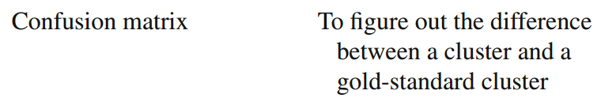
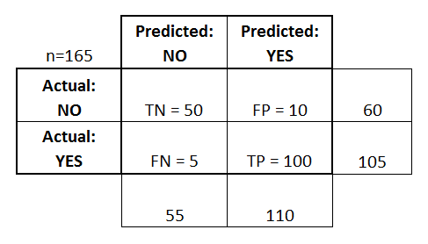
Evaluation indicator (external evaluators – gold standard)
The main purpose of an evaluation indicator is to test the validity of algorithm.
Färber I, Günnemann S, Kriegel H, Kröger P, Müller E, Schubert E, Seidl T, Zimek A (2010) On using class-labels in evaluation of clusterings. In MultiClust: 1st international workshop on discovering, summarizing and using multiple clusterings held in conjunction with KDD, Washington, DC

Slide 13
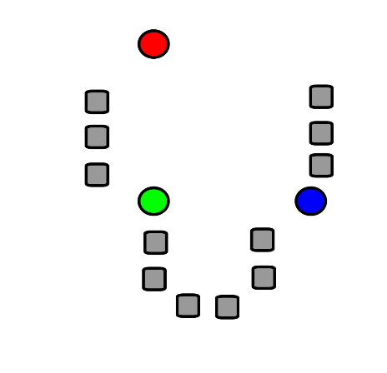
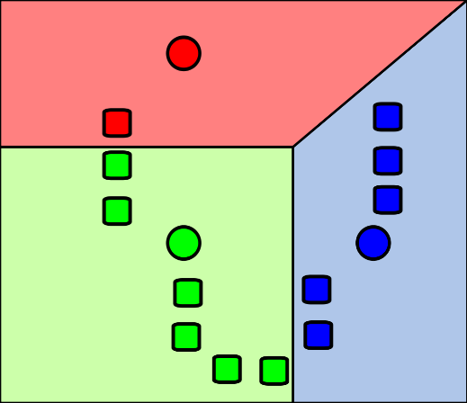
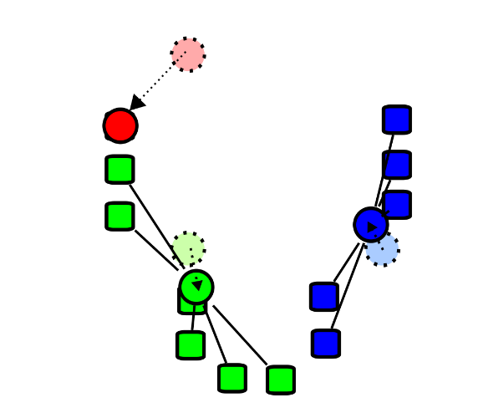
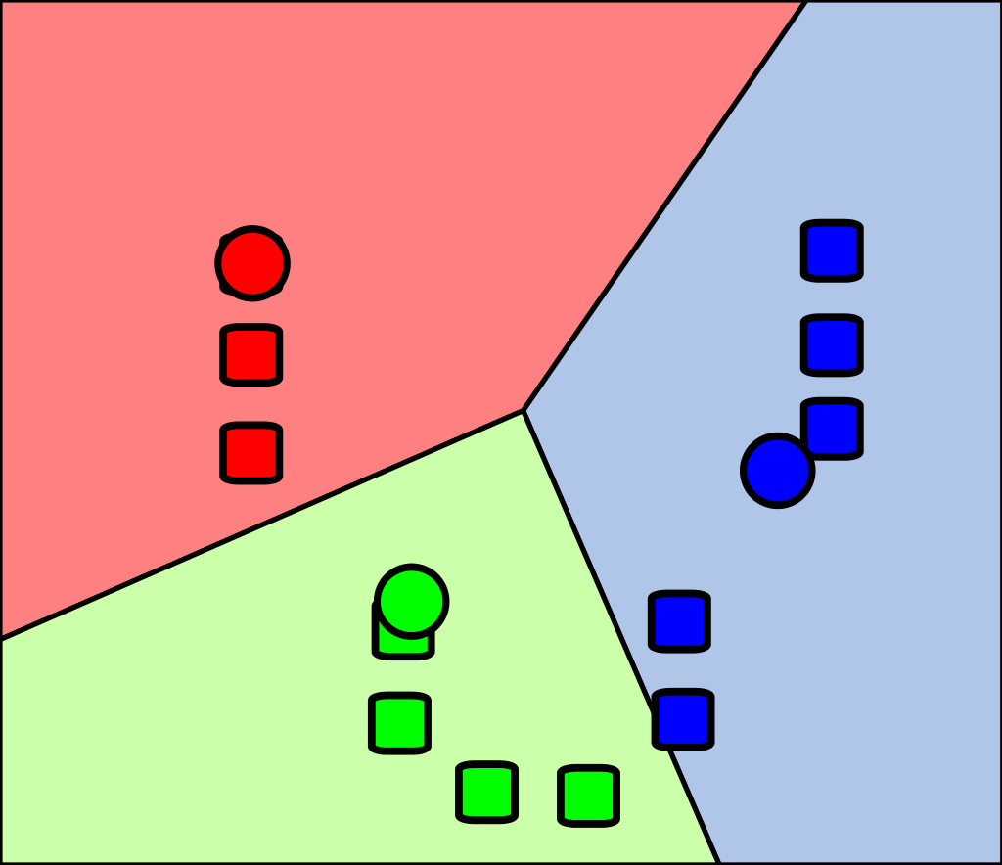
https://en.wikipedia.org/wiki/K-means_clustering
Traditional clustering algorithms
Clustering algorithms based on partition.
k-means
The basic idea of this kind of clustering algorithms is to regard the center of data points as the center of the corresponding cluster.

Slide 14
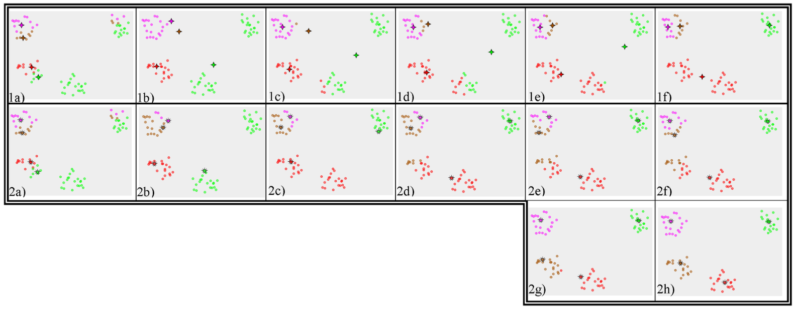
Traditional clustering algorithms
Clustering algorithms based on partition.
Other algorithms:
- k-medoids chooses datapoints as centers (medoids or exemplars) and can be used with arbitrary distances.
https://en.wikipedia.org/wiki/K-medoids

Slide 15
Traditional clustering algorithms
Clustering algorithms based on partition.
Other algorithms:
CLARA: Clustering for LARge Applications
Kaufman L, Rousseeuw P (2008) Finding groups in data: an introduction to cluster analysis, vol 344.
Wiley, Hoboken. doi:10.1002/9780470316801
CLARANS:
Ng R, Han J (2002) Clarans: a method for clustering objects for spatial data mining. IEEE Trans
Knowl Data Eng 14:1003–1016

Slide 16
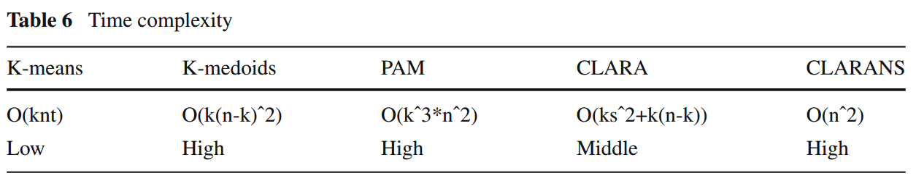
Traditional clustering algorithms
Clustering algorithms based on partition. Analysis.
“A Comprehensive Survey of Clustering Algorithms”, D. Xu and Y. Tian. Ann. Data. Sci. (2015) 2(2):165–193 DOI 10.1007/s40745-015-0040-1

Slide 17
Traditional clustering algorithms
Clustering algorithms based on partition. Analysis.
Advantages: suitable for the data set with arbitrary shape and attribute of arbitrary
type, the hierarchical relationship among clusters easily detected, and relatively
high scalability in general;
Disadvantages: relatively high in time complexity in general, the number of clusters needed to be preset
“A Comprehensive Survey of Clustering Algorithms”, D. Xu and Y. Tian. Ann. Data. Sci. (2015) 2(2):165–193 DOI 10.1007/s40745-015-0040-1

Slide 18
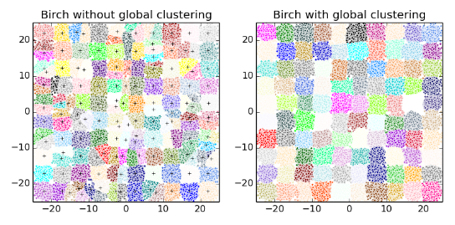
Traditional clustering algorithms
Clustering algorithms based on hierarchy.
BIRCH achieves the clustering result by constructing the feature tree of clustering of which one node stands for a subcluster. The feature tree will dynamically grow when a new data point comes.
Zhang T, Ramakrishnan R, Livny M (1996) BIRCH: an efficient data clustering method for very large databases. ACM SIGMOD Rec 25:103–104
The basic idea of this kind of clustering algorithms is to construct the hierarchical relationship among data in order to cluster.

Slide 19
Traditional clustering algorithms
Clustering algorithms based on hierarchy.
CURE, suitable for large-scale clustering, takes random sampling technique to cluster sample separately and integrates the results finally.
Guha S, Rastogi R, Shim K (1998) CURE: an efficient clustering algorithm for large databases. ACM SIGMOD Rec 27:73–84
Chameleon, at first, divides the original data into clusters with smaller size based on the nearest neighbor graph, and then the clusters with small size are merged into a cluster with bigger size, based on agglomerative algorithm, until satisfied.
Karypis G, Han E, Kumar V (1999) Chameleon: hierarchical clustering using dynamic modeling. Computer 32:68–75
The basic idea of this kind of clustering algorithms is to construct the hierarchical relationship among data in order to cluster.

Slide 20
Traditional clustering algorithms
Clustering algorithms based on hierarchy. Analysis.
Advantages: suitable for the data set with arbitrary shape and attribute of arbitrary
type, the hierarchical relationship among clusters easily detected, and relatively
high scalability in general;
Disadvantages: relatively high in time complexity in general, the number of clusters needed to be preset
“A Comprehensive Survey of Clustering Algorithms”, D. Xu and Y. Tian. Ann. Data. Sci. (2015) 2(2):165–193 DOI 10.1007/s40745-015-0040-1

Slide 21
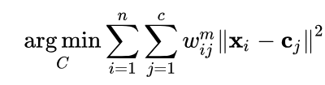
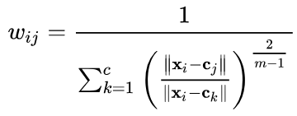
Traditional clustering algorithms
Clustering algorithms based on fuzzy theory.
FCM: Fuzzy c-means
Procedure:
Determine a number of clusters.
Assign coefficients randomly to each data point for being in the clusters.
Repeat until the algorithm has converged (that is, the coefficients' change between two iterations is no more than the given sensitivity threshold).
Compute the centroid for each cluster.
For each data point, compute its coefficients of being in the clusters.
Bezdek J, Ehrlich R, Full W (1984) FCM: the fuzzy c-means clustering algorithm. Comput Geosci10:191–203
The central idea in fuzzy clustering is the non-unique partitioning of the data in a collection of clusters.

Slide 22
Traditional clustering algorithms
Clustering algorithms based on fuzzy theory.
FCS: Fuzzy c shells
Detection of clusters that lie in nonlinear subspaces, i.e. resemble shells or patches of surfaces with no interior points. These clusters can be detected using fuzzy shell clustering algorithms.
Dave R, Bhaswan K (1992) Adaptive fuzzy c-shells clustering and detection of ellipses. IEEE TransNeural Netw 3:643–662
The central idea in fuzzy clustering is the non-unique partitioning of the data in a collection of clusters.

Slide 23
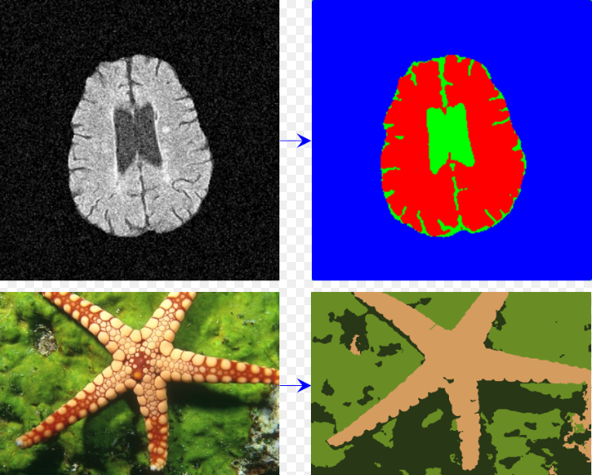
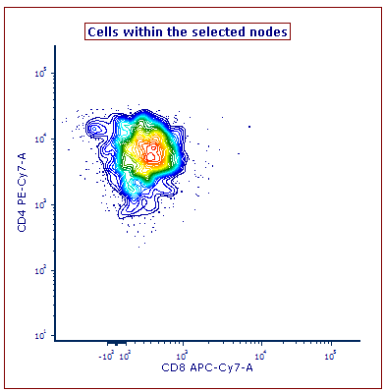
Traditional clustering algorithms
Clustering algorithms based on fuzzy theory. Examples.
https://www.mathworks.com/matlabcentral/fileexchange/66181-image-segmentation-using-fast-fuzzy-c-means-clusering
https://www.denovosoftware.com/site/kb-Spade.shtml
The central idea in fuzzy clustering is the non-unique partitioning of the data in a collection of clusters.

Slide 24
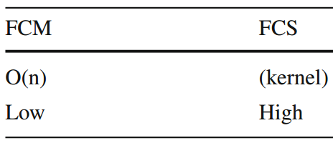
Time complexity of fuzzy clustering methods
Traditional clustering algorithms
Clustering algorithms based on fuzzy theory. Analysis.
The time complexity of FCS is high for the kernel involved in the algorithm.
Advantages: more realistic to give the probability of belonging, relatively high accuracy of clustering.
Disadvantages: relatively low scalability in general, easily drawn into local optimal, the clustering result sensitive to the initial parameter values, and the number of clusters needed to be preset.
The central idea in fuzzy clustering is the non-unique partitioning of the data in a collection of clusters.

Slide 25
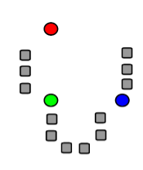
Traditional clustering algorithms
Xu X, Ester M, Kriegel H, Sander J (1998) A distribution-based clustering algorithm for mining in large spatial databases. In: Proceedings of the fourteenth international conference on data engineering, pp 324-331.
Clustering algorithms based on density.
DBCLASD: Distribution-Based Clustering of LArge Spatial Databases
This algorithm discovers clusters with arbitrary shape and with minimal number of input parameters: the radius of the cluster and minimum points required inside the cluster.
R. Pushpalatha, K. M. Sundaram ”A Survival Study on Density Based Clustering Algorithms for Large Spatial Databases in Data Mining”, South Asian Journal of Engineering and Technology Vol.2, No.17 (2016) 370–377
The basic idea of this kind of clustering algorithms is that the data within the region with high density of the data space is considered to belong to the same cluster.

Slide 26
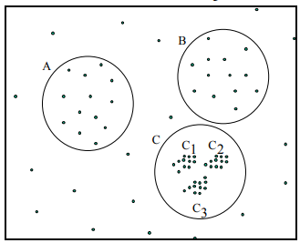
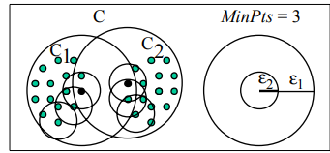
Traditional clustering algorithms
Clustering algorithms based on density.
Ankerst M, Breunig M, Kriegel H, Sander J (1999) OPTICS: ordering points to identify the clustering structure. In: Proceedings on 1999 ACM SIGMOD international conference on management of data, vol 28, pp 49–60.
OPTICS: Ordering points to identify the clustering structure
Similar to DBSCAN, however, the problem of detecting meaningful clusters in data of varying density is addressed.
The basic idea of this kind of clustering algorithms is that the data within the region with high density of the data space is considered to belong to the same cluster.

Slide 27
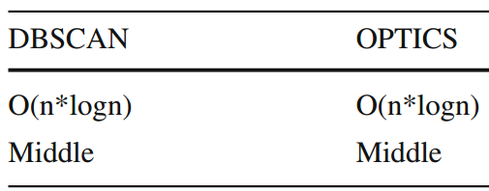
Traditional clustering algorithms
Clustering algorithms based on density. Analysis.
Advantages: clustering in high efficiency and suitable for data with arbitrary shape.
Disadvantages: resulting in a clustering result with low quality when the density of data space isn’t even, a memory with big size needed when the data volume is big, and the clustering result highly sensitive to the parameters.
Time complexity of density-based clustering methods
The basic idea of this kind of clustering algorithms is that the data within the region with high density of the data space is considered to belong to the same cluster.

Slide 28
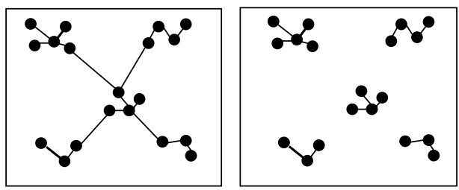
Traditional clustering algorithms
Clustering algorithms based on graph theory.
Jain A, Murty M, Flynn P (1999) Data clustering: a review. ACM Comput Surv (CSUR) 31:264–323
MST: Spanning Tree
From a graph (tree) representing the data points, a threshold value and step size then a MST (minimum spanning tree) is obtained (cluster).
Graph theory-based clustering algorithms rely on a graph where the node is regarded as the data point and the edge is regarded as the relationship among data points.

Slide 29
Traditional clustering algorithms
Clustering algorithms based on graph theory.
CLICK: CLuster Identification via Connectivity Kernels
The core idea of CLICK is to carry out the minimum weight division of the graph with iteration in order to generate the clusters.
Applications to Gene Expression Analysis.
Sharan R, Shamir R (2000) CLICK: a clustering algorithm with applications to gene expression analysis. In: Proc international conference intelligent systems molecular biolgy, pp 307–316.
Graph theory-based clustering algorithms rely on a graph where the node is regarded as the data point and the edge is regarded as the relationship among data points.

Slide 30
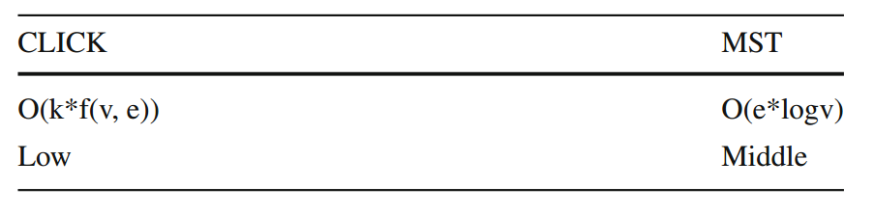
Traditional clustering algorithms
Clustering algorithms based on graph theory. Analysis.
Advantages: clustering in highly efficient and the clustering result is accurate.
Disadvantages: the time complexity increasing dramatically with the increasing
of graph complexity.
Time complexity of graph theory-based clustering methods
Graph theory-based clustering algorithms rely on a graph where the node is regarded as the data point and the edge is regarded as the relationship among data points.

Slide 31
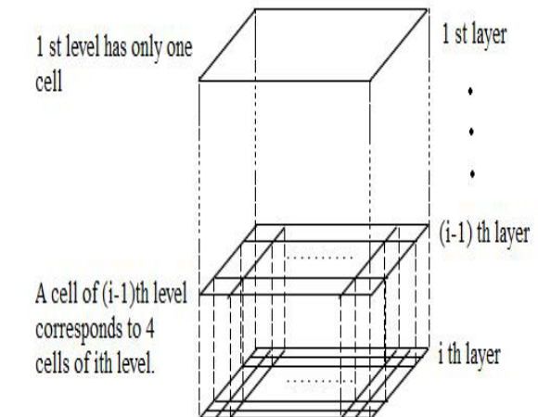
Traditional clustering algorithms
Clustering algorithms based on grid.
STING: A statistical information grid approach
A set of grid-cells is defined, then data points are assigned to the appropriate grid cell and compute the density of each cell and eliminate cells, whose density is below a defined threshold. There’s a priori statistical knowledge of the space data.
A Survey on STING and CLIQUE Grid Based Clustering Methods. Suman and Pinki Rani.
The grid based clustering approach uses a multiresolution grid data structure. It quantizes the object space into a finite number of cells that form a grid structure on which all of the operations for clustering are performed. T

Slide 32
Traditional clustering algorithms
Clustering algorithms based on grid.
A Survey on STING and CLIQUE Grid Based Clustering Methods. Suman and Pinki Rani.
CLIQUE: A dimension growth subspace clustering method
CLIQUE takes advantage of the grid-based clustering algorithms and the density-based clustering algorithms.
The grid based clustering approach uses a multiresolution grid data structure. It quantizes the object space into a finite number of cells that form a grid structure on which all of the operations for clustering are performed. T

Slide 33
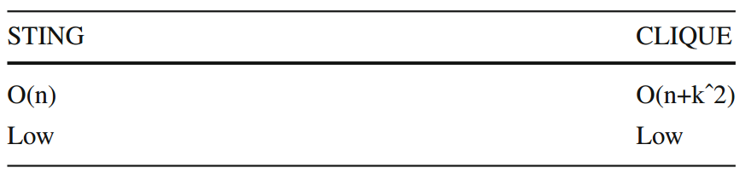
Traditional clustering algorithms
Clustering algorithms based on grid. Analysis.
Advantages: low time complexity, high scalability and suitable for parallel processing and increment updating.
Disadvantages: the clustering result sensitive to the granularity (the mesh size), the high calculation efficiency at the cost of reducing the quality of clusters and reducing the clustering accuracy.
Time complexity of grid-based clustering methods

Slide 34
Traditional clustering algorithms
Clustering algorithms based on model.
There are mainly two kinds of model-based clustering algorithms, one based on statistical learning methods and the other based on neural network learning methods.
The basic idea is to select a particular model for each cluster and find the best fitting for that model.
Fisher D (1987) Knowledge acquisition via incremental conceptual clustering. Mach Learn 2:139–172
“A Comprehensive Survey of Clustering Algorithms”, D. Xu and Y. Tian. Ann. Data. Sci. (2015) 2(2):165–193 DOI 10.1007/s40745-015-0040-1

Slide 35
Traditional clustering algorithms
Clustering algorithms based on model.
“A Comprehensive Survey of Clustering Algorithms”, D. Xu and Y. Tian. Ann. Data. Sci. (2015) 2(2):165–193 DOI 10.1007/s40745-015-0040-1
Statistical methods
Neural network
methods
SOM
ART
COBWEB
GMM
Classification tree
Gaussian distribution
Mapping for dimension reduction
Create neurons when necessary

Slide 36
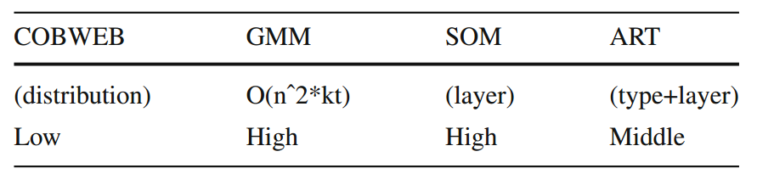
Traditional clustering algorithms
Clustering algorithms based on model. Analysis.
Advantages: diverse and well developed models providing means to describe data adequately and each model having its own special characters that may bring about some significant advantages in some specific areas.
Disadvantages: relatively high time complexity in general, the premise not completely correct, and the clustering result sensitive to the parameters of selected models.
Time complexity of model-based clustering methods

Slide 37
Modern clustering algorithms
Clustering algorithms based on kernel.
These clustering algorithms consider a transformation of the input data (input space) into a high dimensional feature space by a nonlinear mapping for the cluster analysis.
Typical algorithms:
kernel K-means.
kernel SOM.
kernel FCM.
Support vector clustering (SVC).
These methods take advantage of the kernel method and the original clustering algorithm.
A. Ben-Hur et al. “Support Vector Clustering”, Journal of Machine Learning Research 2 (2001) 125-137.

Slide 38
Modern clustering algorithms
Clustering algorithms based on kernel. Analysis.
The time complexity of this kind of clustering algorithms is generally high for the kernel involved in the algorithm.
Advantages: more easy to cluster in the high dimensional feature space, suitable for data with arbitrary shape, able to analyze the noise and separate the overlapping clusters, and not needed to have the preliminary knowledge about the topology of data.
Disadvantages: the clustering result sensitive to the type of kernel and its parameters, time complexity being high, and not suitable for large-scale data.

Slide 39
Modern clustering algorithms
Clustering algorithms based on Ensemble.
The core idea is to generate a set of initial clustering results by a particular method and the final clustering result is obtained by integrating the initial clustering results.
Four methods:
(1) For the same data set, employ the same algorithm with the different parameters or the different initial conditions.
(2) For the same data set, employ the different algorithms.
(3) For the subsets, carry out the clustering respectively.
(4) For the same data set, carry out the clustering in different feature spaces based on
different kernels.

Slide 40
Modern clustering algorithms
Clustering algorithms based on Ensemble.
The initial clustering results are integrated by means of the consensus function.
Based on co-association matrix.
Based on graph partition.
Based on relabeling and voting.
Based on the hybrid model.
Based on information theory.
Based on genetic algorithm.
Based on local adaptation.
Based on kernel method.
Based on fuzzy theory
Some consensus functions!

Slide 41
Modern clustering algorithms
Clustering algorithms based on Ensemble. Analysis.
The time complexity of this kind of algorithm is based on the specific method and algorithms involved in the proposal.
Advantages: robust, scalable, able to be parallel and taking advantage of the strengths of the involved algorithms.
Disadvantages: inadequate understanding about the difference among the initial clustering results, existing deficiencies of the design of the consensus function.
“A Comprehensive Survey of Clustering Algorithms”, D. Xu and Y. Tian. Ann. Data. Sci. (2015) 2(2):165–193 DOI 10.1007/s40745-015-0040-1

Slide 42
Other modern clustering algorithms
Clustering Algorithm Based on Swarm Intelligence.
Clustering Algorithm Based on Quantum Theory.
Clustering Algorithm Based on Spectral Graph Theory.
Clustering Algorithm Based on Affinity Propagation.
Clustering Algorithm Based on Density and Distance.
Clustering Algorithm for Spatial Data.
Clustering Algorithm for Data Stream.
Clustering Algorithm for Large-Scale Data.
“A Comprehensive Survey of Clustering Algorithms”, D. Xu and Y. Tian. Ann. Data. Sci. (2015) 2(2):165–193 DOI 10.1007/s40745-015-0040-1

Slide 43
Exercise (Clustering)
Given a particular dataset (provided by the teacher), select the proper clustering algorithm. Justify your selection.
Implement the selected algorithm and cluster the provided dataset.
Compare your results vs. a given gold standart.
Conclusions.

